Slide 1
How to merge bibliographic records in batch
using the job Merge Records and Combine Inventory
Yoel Kortick
Senior Librarian

Slide 2
Agenda
Introduction
Running the prerequisite Duplicate Title Analysis job
Running the Merge Records and Combine Inventory job
The results of the Merge Records and Combine Inventory job
Another example
2

Slide 3
Introduction

Slide 4
Introduction
The “Merge Records and Combine Inventory” job is used to merge duplicate records.
The duplicate records to be merged are taken from the report file (.csv) from the job Duplicate Title Analysis.
The “Merge Records and Combine Inventory” job assumes that when the Duplicate Title Analysis job was run either “Record with the most items” or “Record with the highest brief level” was chosen as the Preferred record options.
This is because the Merge Records and Combine Inventory job uses the preferred and merge information from the “Operation” column to determine how to process the duplicate records.
In addition to this presentation see also Using Merge Records and Combine Inventory .

Slide 5
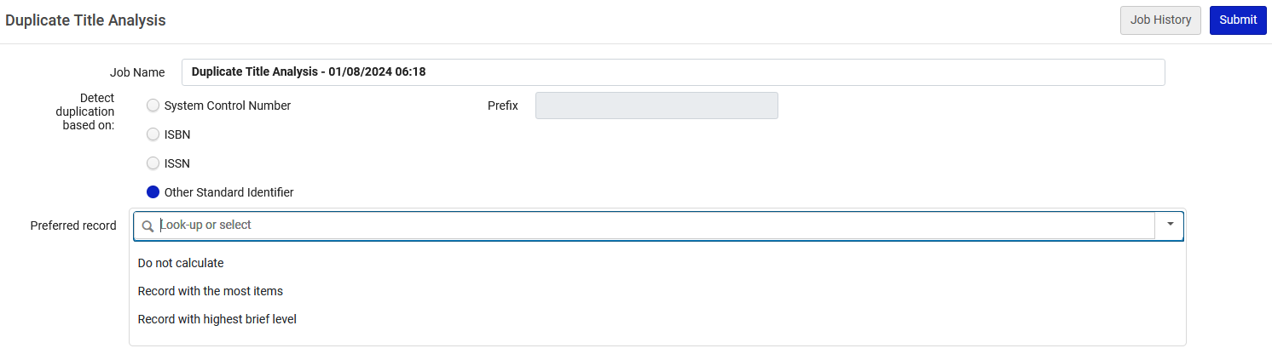
Introduction
The “Merge Records and Combine Inventory” job assumes when the Duplicate Title Analysis job was run either “Record with the most items” or “Record with the highest brief level” was chosen as the Preferred record options.

Slide 6
Introduction
Before running the “Merge Records and Combine Inventory” job on many records, it is advised to first run on a small number of records and confirm that the results are as desired. Test can also be initially done in the sandbox environment.
Because the Merge Records and Combine Inventory job is irreversible, the input number of groups is limited to 100 (we will later see what a ”group” is). This is designed to minimize unintentional data corruption.
The “Duplicate Title Analysis” job's report should therefore be split into bulks of up to 100 groups and then the job should be run for each bulk.

Slide 7
Running the prerequisite Duplicate Title Analysis job

Slide 8
Running the prerequisite Duplicate Title Analysis job
Before we run the Merge Records and Combine Inventory job we need to run the Duplicate Title Analysis job.
This is because the output of the Duplicate Title Analysis job is used as input for the “Merge Records and Combine Inventory” job.

Slide 9
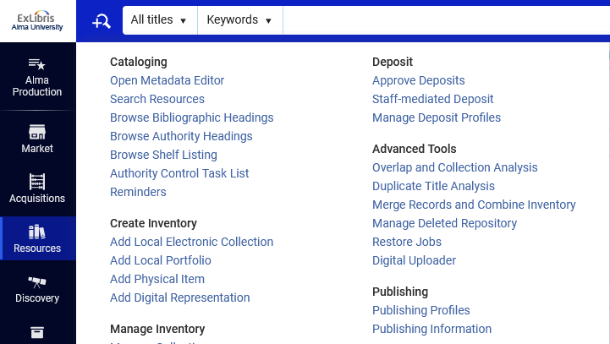
Running the prerequisite Duplicate Title Analysis job
The job Duplicate Title Analysis can be run from “Resources > Advanced Tools > Duplicate Title Analysis”

Slide 10
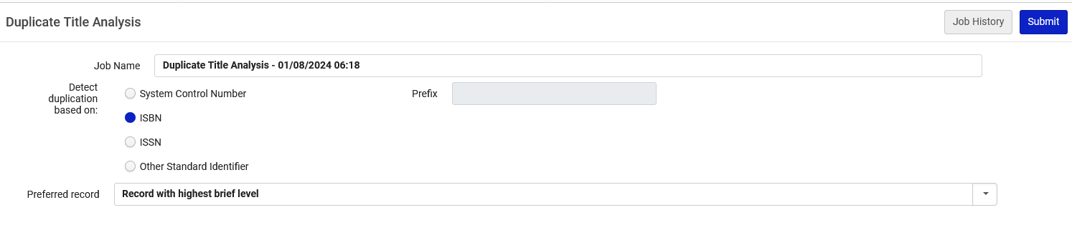
Running the prerequisite Duplicate Title Analysis job
Here we run the job Duplicate Title Analysis to match by ISBN and have the preferred record be the record with the highest brief level.

Slide 11
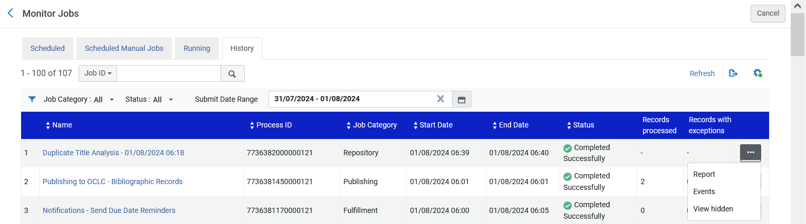
Running the prerequisite Duplicate Title Analysis job
From the “Monitor Jobs” “History” tab we will access the report of the job

Slide 12
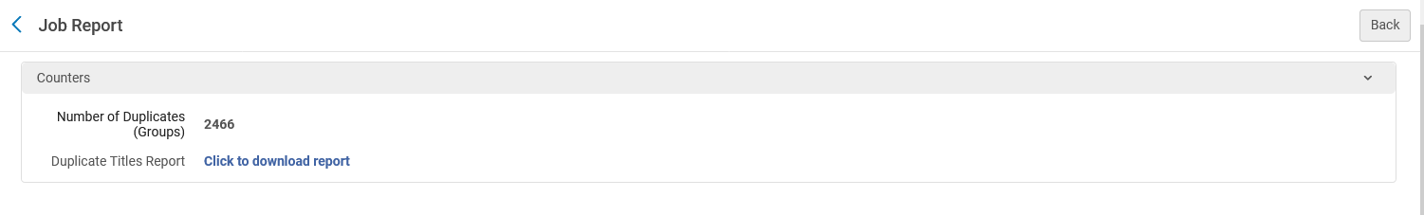
Running the prerequisite Duplicate Title Analysis job
From the report of the job, we download the results (which will later be used as input for the as input for the “Merge Records and Combine Inventory” job).
A .csv file is downloaded

Slide 13
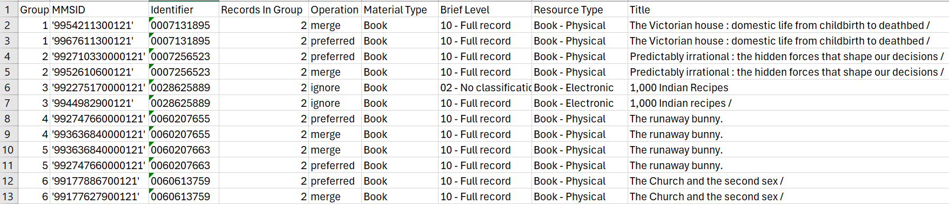
Running the prerequisite Duplicate Title Analysis job
Here is part of the results
Note that records with Electronic inventory will be ignored by the job “Merge and Combine Inventory”
These are the “Groups” to which we previously referred
Let’s look for example at ISBN 0007256523, title “Predictably irrational : the hidden forces that shape our decisions”

Slide 14
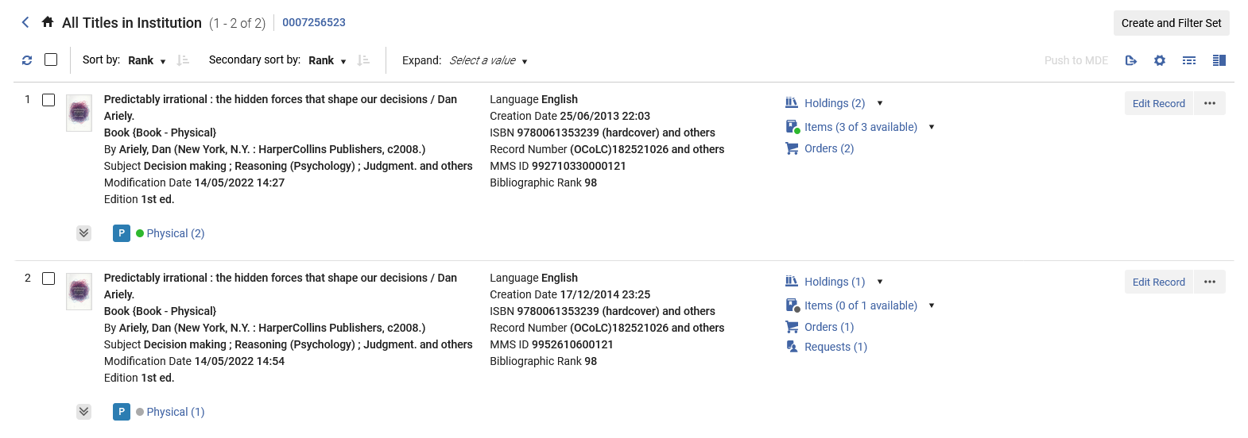
Running the prerequisite Duplicate Title Analysis job
We see two bibliographic records, both of which have holdings, items and orders. One record also has a request.
We now have a total of
3 Holdings Records
4 items (3 available and 1 not available)
3 Orders
1 Request

Slide 15
Running the prerequisite Duplicate Title Analysis job
For testing purposes, we have modified the output of the Duplicate Title Analysis job and put only the one group with ISBN 0007256523 (Title “Predictably irrational : the hidden forces that shape our decisions”).
This way we can run and test the “Merge and Combine Inventory” on this specific record only and check the result.
We will now use this file with one group as input for the job “Merge and Combine Inventory”

Slide 16
Running the Merge Records and Combine Inventory job

Slide 17
Running the Merge Records and Combine Inventory job
The job “Merge Records and Combine Inventory” can be run from “Resources > Advanced Tools > Merge Records and Combine Inventory ”

Slide 18
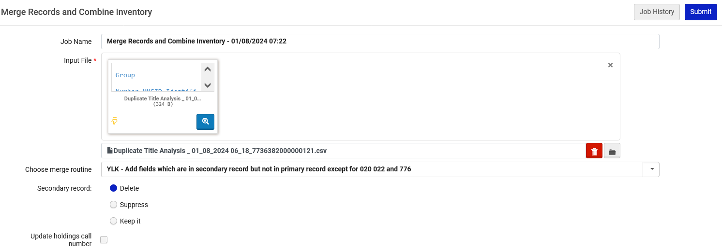
Running the Merge Records and Combine Inventory job
Here we run the job.
We will leave the default job name which is “Merge Records and Combine Inventory – {date and time}
This is the input file with one group which we made from the output of the job Duplicate Title Analysis
This is the chosen merge routine
We will delete the secondary record

Slide 19
The results of the Merge Records and Combine Inventory job

Slide 20
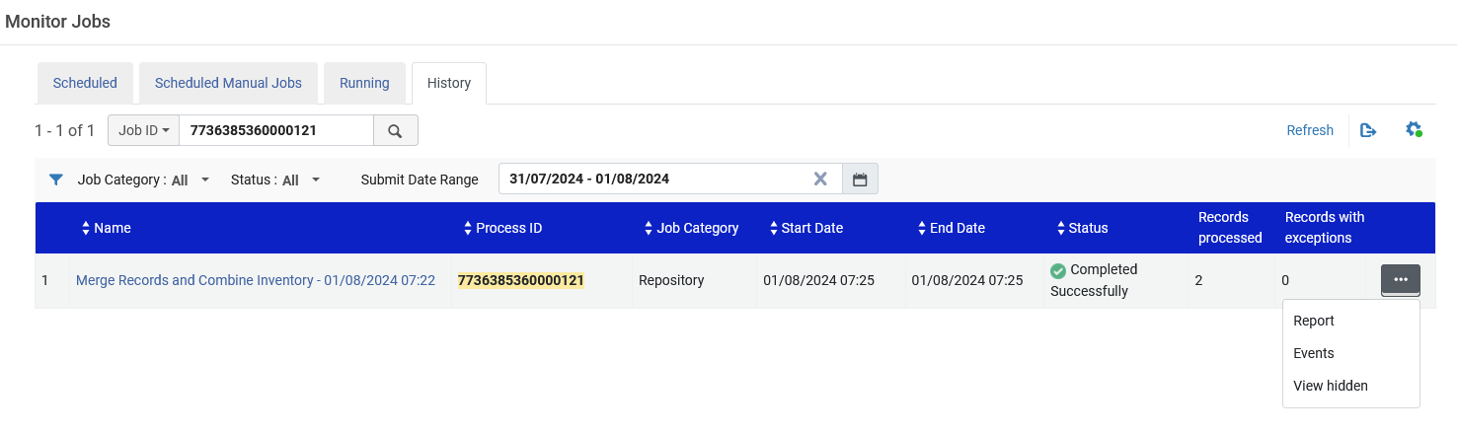
The results of the Merge Records and Combine Inventory job
The job completes and we check the report

Slide 21
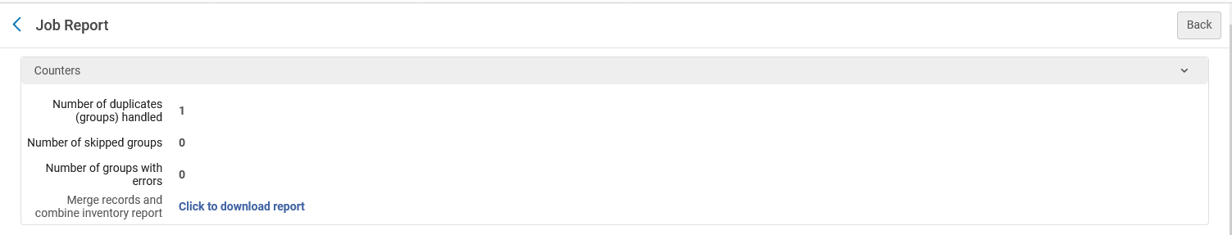
The results of the Merge Records and Combine Inventory job
We will download the report
One group was handled because we had only one group in the input file.

Slide 22
The results of the Merge Records and Combine Inventory job
Columns A – I state which records were handled in the Merge records and Combine Inventory job.

Slide 23
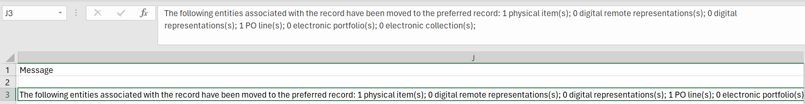
The results of the Merge Records and Combine Inventory job
Columns J states which entities have been moved to the preferred record

Slide 24
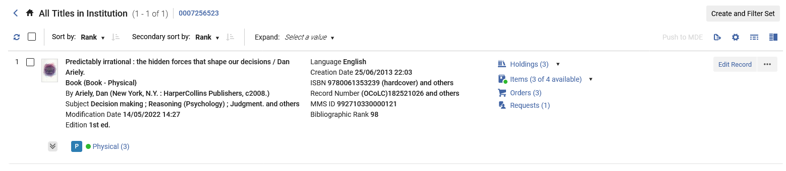
The results of the Merge Records and Combine Inventory job
Now ISBN 0007256523 has only one record (previously it had two)
We now have a total of
3 Holdings Records
4 items (3 available and 1 not available)
3 Orders
1 Request
This is a correct combination of entities of the two merged records (see slide with screenshot from before the merge)

Slide 25
Another example

Slide 26
Another example
For testing purposes, we have modified the output of the Duplicate Title Analysis job and put only the one group with ISBN 0078812623 (Title “Windows programming secrets”).
This way we can run and test the “Merge and Combine Inventory” on this specific record only and check the result.
We will now use this file with one group as input for the job “Merge and Combine Inventory”
MMSID 991316750000121 is the non preferred record.
MMSID 991184550000121 is the preferred record.

Slide 27
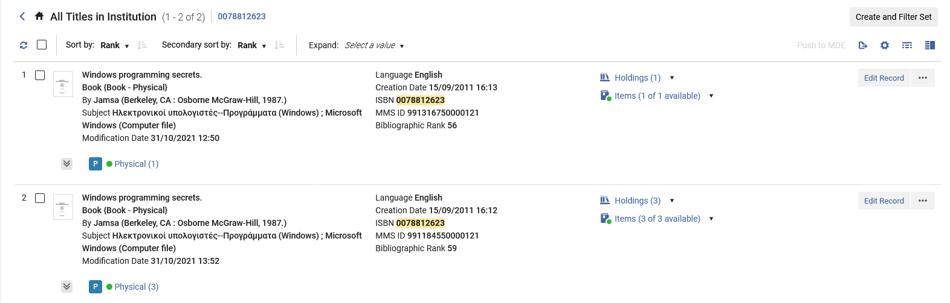
Another example
We see two bibliographic records, both of which have holdings and items.
We now have a total of
4 Holdings Records
4 items (4 available)

Slide 28
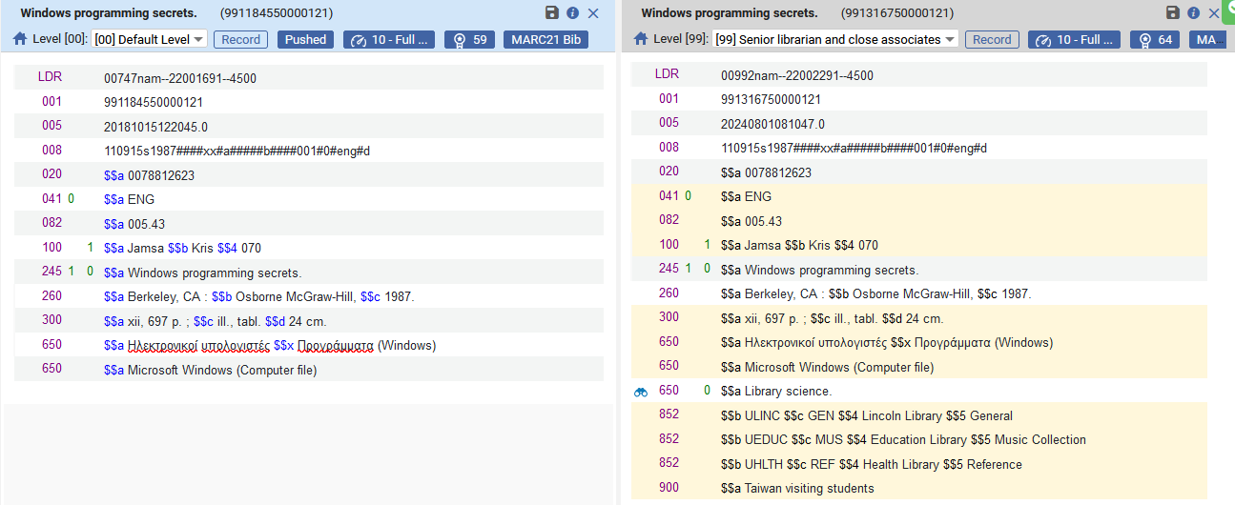
Another example
The secondary record to merge, MMSID 991316750000121, has fields which do not exist in the preferred record MMSID 991184550000121.

Slide 29
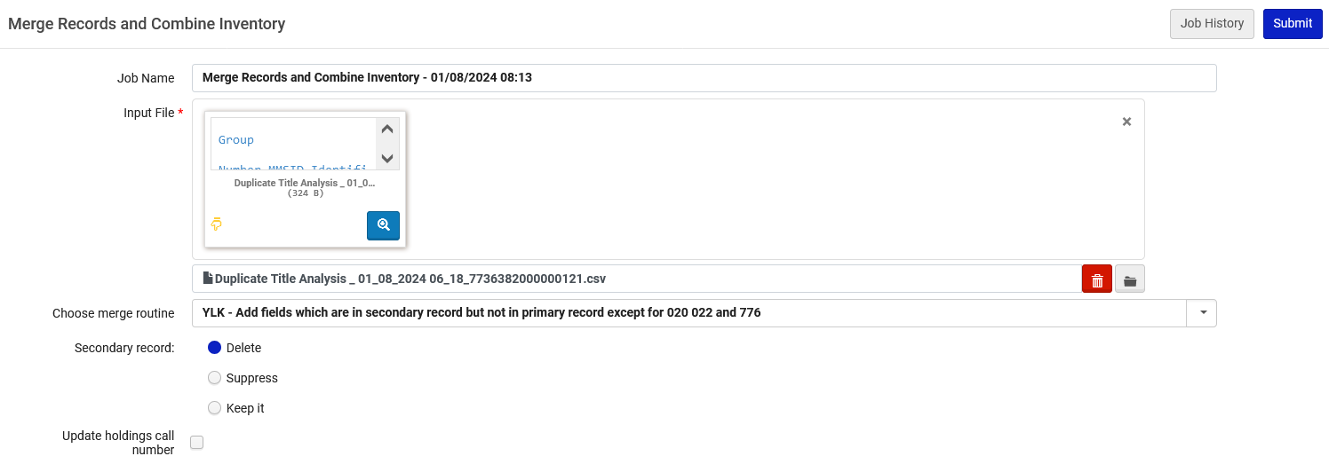
Another example
Here we run the job.
We will leave the default job name which is “Merge Records and Combine Inventory – {date and time}
This is the input file with one group which we made from the output of the job Duplicate Title Analysis
This is the chosen merge routine
We will delete the secondary record

Slide 30
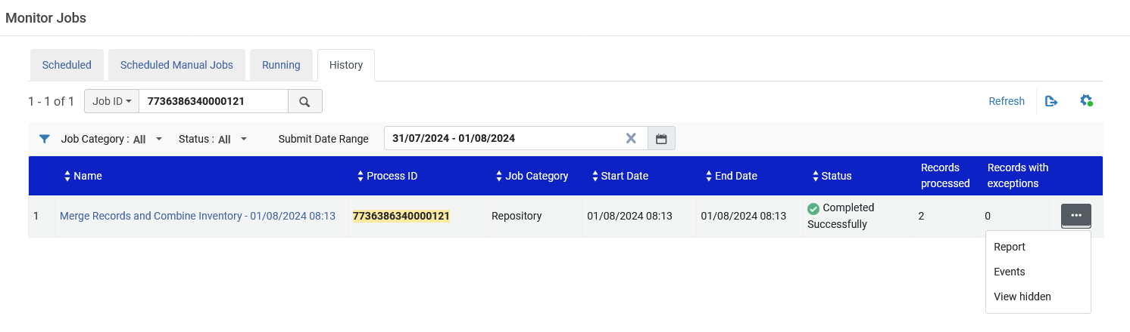
Another example
The job completes and we check the report

Slide 31
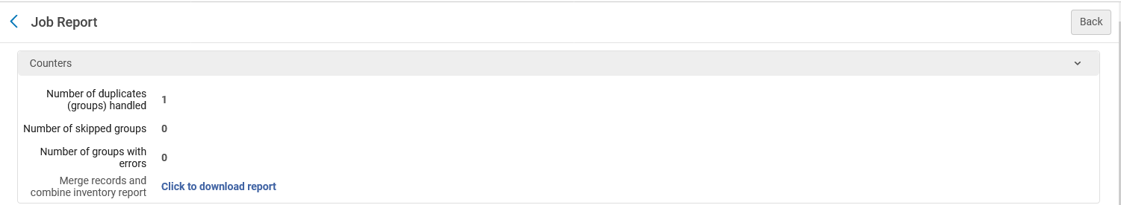
Another example
We will download the report
One group was handled because we had only one group in the input file.

Slide 32
Another example
Columns A – I state which records were handled in the Merge records and Combine Inventory job.

Slide 33
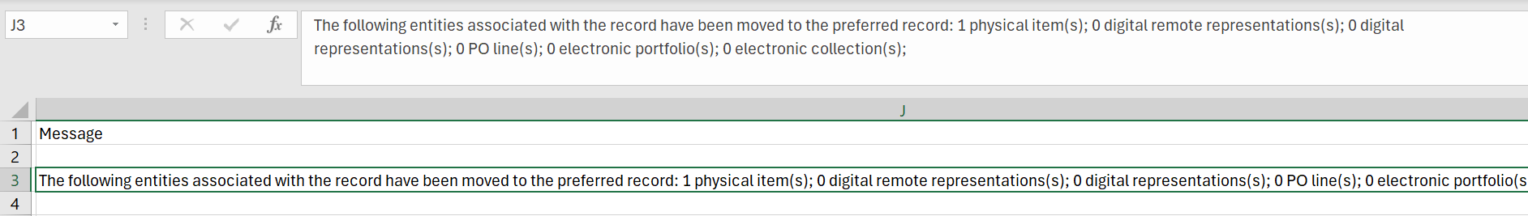
Another example
Columns J states which entities have been moved to the preferred record

Slide 34
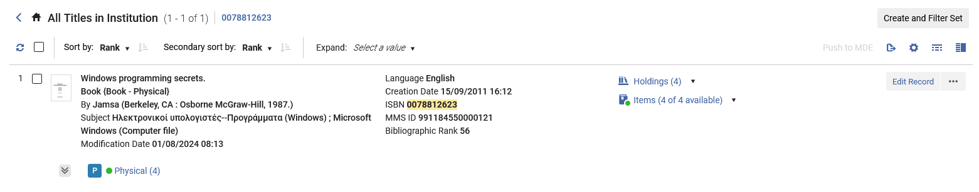
Another example
Now ISBN 0078812623 has only one record (previously it had two)
We now have a total of
4 Holdings Records
4 items (4 available)
This is a correct combination of entities of the two merged records (see slide with screenshot from before the merge)

Slide 35
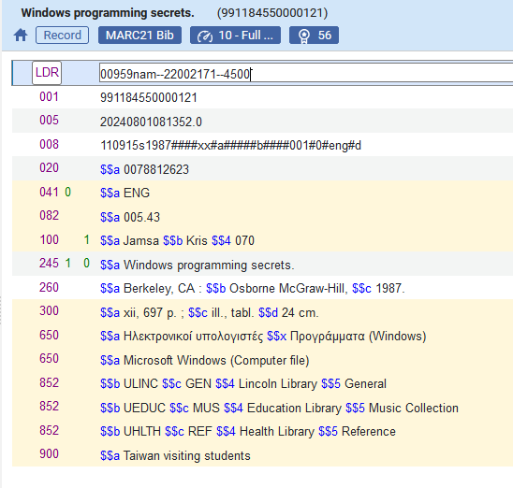
Another example
The bibliographic record has fields which were copied from the secondary record as a result of the merge routine chosen when running the job.
These 852 and 900 fields existed in the secondary record and not in the preferred record (see slide with screenshot from before the merge) and thus as a result of the conditions in the specific merge routine chosen when running the “Merge and Combine Inventory job” they were copied to the preferred record during merge.

Slide 36
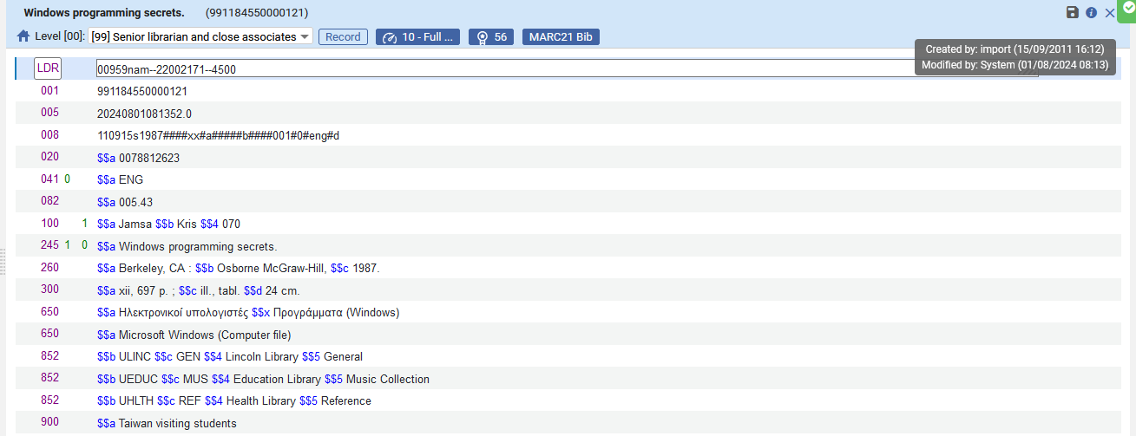
Another example
We can also see that the bibliographic record was updated by “System” (which in this case is the “Merge and Combine Inventory” job) at the time the job was run.

Slide 37
Thank You

